Slide 1
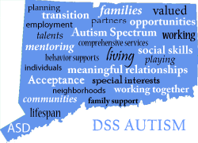
State of Connecticut
Department of Social Services
State of Connecticut
Department of Social Services
Division of Autism Spectrum Services
Nathaniel Calixto, MA

Slide 2
In July 2006, the Autism Spectrum Disorder Pilot Program was established under the Department of Developmental Services (DDS) Section 37 of Public Act 06-188
The pilot program began in New Haven county in July 2006 and then expanded to Hartford county in August 2008.
In 2011, Public Act 11-4 established the Division of Autism Spectrum Disorder Services.
Both the Pilot, and the Autism Division were established to fill a void in services for individuals with autism who do not have an intellectual disability.
The pilot originally served individuals with ASD over the age of 18. It was later opened to those age 3 through the lifespan.
To be eligible to receive services from the Division of Autism an individual must have:
PRIMARY diagnosis of autism
A full-scale IQ of 70 or above
At least three years of age
Legal residency in Connecticut
Medicaid eligibility
Impairment prior to age 22
Impairment expected to continue indefinitely
Reside in their own home or their family home

Slide 3
Effective July 1, 2016 the Division of Autism Spectrum Disorder Services was transferred from the Department of Developmental Services to the Department of Social Services (Section 47 of Public Act 16-3, An Act Concerning Revenue and Other Items to Implement the Budget for the Biennium Ending June 30, 2017)
The transition included the DDS staff dedicated to the Autism Division and two autism waivers:
Waiver For Persons With Autism (Lifespan Waiver)
Early Childhood Autism Waiver (ECAW) ***officially closed in 2018***
The Division of Autism staff consists of:
A Program Manager
One Administrative Assistant
Two Autism Support and Resource Specialists
Four Case Managers
One Case Manager Supervisor

Slide 4
What is a Waiver?
The Waiver For Persons With Autism is a Home and Community Based (HCBS) Waiver under Medicaid. This waiver allows Connecticut to receive partial reimbursement from the Federal Government for providing needed community-based programs and supports designed to enable individuals to leave an institutional setting or to prevent their placement in one in the first place. The Federal Government reimburses Connecticut 50% of the cost of services and support through the Medicaid program; therefore a person must be a Medicaid member to participate.

Slide 5
Medicaid Waivers
A Medicaid waiver allows the state to “waive” certain federal requirements within the Medicaid Program. These waivers permit the state to do the following:
Offer services that are not available under the present state plan
Limit the amount of spending per person
Limit the number of individuals served
Utilize special “institutional” eligibility requirements primarily related to income
Medicaid provides Connecticut reimbursement for ASD services through two distinct Medicaid payment methods:
Medicaid Waiver (Autism Lifespan Waiver)
Medicaid State Plan Services

Slide 6
Waiver For Persons With Autism (Lifespan Waiver)
The Department of Social Services Waiver for Persons with Autism provides home-and community-based services to individuals with autism who do not have an intellectual disability (individuals must have a full IQ score of 70 or higher).
Services provided under the waiver include:
Behavioral Services
Job Coaching
Community Mentor
Life Skills Coach
Social Skills group
Respite (In-home and Out-of-home)
Assistive Technology
Interpreter
Specialized Driving Assessment
Personal Emergency Response System
Individual Goods and Service
Non-Medical Transportation
***The Waiver for Persons with Autism is not an entitlement; therefore, services and access to services under the ASD waiver may be limited, based on available funding and program capacity. A waiting list applies.

Slide 7
Lifespan Waiver Cont’d
The Autism Lifespan Waiver recently was approved 50 slots and an additional 150 slots beginning SFY 2023.
Maximum Waiver cap per person per year: $50,000
***As of 3/14/2022, there are 1974 individuals on the wait list.

Slide 8
Connecticut: Autism Insurance Reform Law
The Autism Insurance Reform Law (SB 301/Public Act 09-115) was enacted on June 9, 2009. It became effective January 1, 2010 and required fully insured group health insurance plans to provide coverage for autism services to children under the age of 15 years.
ASD services covered by the law include:
• Diagnosis
• Behavioral Therapy
• Prescription drugs
• Psychiatric care and Psychological care
• Physical therapy, Speech therapy and Occupational
Therapy
***Self-funded insurance plans (ERISA’s) do not have to comply with State Autism Insurance Reform Laws, although many have made the decision to offer coverage on their own.

Slide 9
State Plan Services
The State Plan for ASD services was the result of guidelines issued by the Centers for Medicare and Medicaid Services (CMS). This required Medicaid programs to cover autism services for individuals under the age of 21, citing the Early and Periodic Screening, Diagnostic and Treatment (EPSDT) child health component under federal law.
The Early and Periodic Screening, Diagnostic and Treatment (EPSDT) benefit provides comprehensive and preventive health care services for children under age 21 who are enrolled in Medicaid. EPSDT is key to ensuring that children and adolescents receive appropriate preventive, dental, mental health, developmental, and specialty services.
Early: Assessing and identifying problems early
Periodic: Checking children's health at periodic, age-appropriate intervals
Screening: Providing physical, mental, developmental, dental, hearing, vision, and other screening tests to detect potential problems
Diagnostic: Performing diagnostic tests to follow up when a risk is identified, and
Treatment: Control, correct or reduce health problems found

Slide 10
State Plan Services Cont’d
The State Plan Services for ASD are managed under the Integrated Care Unit in the Division of Health Services at DSS.
The Autism Lifespan waiver is managed under the Community Options Unit within the Division of Health Services.
Beacon Health Options is the Administrative Service Organization for the State Plan ASD services. They are responsible for reviewing documentation to support level of care guidelines and medical necessity to authorize ASD services for Medicaid (HUSKY A, C and D) members under the age of 21. ***Husky B members are not eligible for State Plan ASD services.
Beacon Health Options also provides Care Coordination and Peer Specialist Services for individuals with ASD.

Slide 11
Autism Spectrum Disorder Services: The State Plan
Autism services available through the Medicaid State Plan (HUSKY A, C and D) for individuals under the age of 21 include:
Comprehensive diagnostic evaluation
Behavioral Assessment
Treatment Plan Development
Development of a Program Book
Direct Intervention
Group Treatment Services (Social Skills groups and Parent groups for members and their families)

Slide 12
Transition Resources
Case Scenario: A parent calls inquiring about services their 18-year-old child may be child may be eligible for since the child may be graduating in June
Disability Benefits w/ SSA
Medicaid- Husky C
Conservatorship
SAGA Cash
SNAP
Non-Driver’s license ID
BRS
IEP, extended transition program and due enrollment information
i.e.

Slide 13
Department of Social Services Website
To access the Division of Autism website: www.ct.gov/dss
Click on Programs and Services
Click on Autism Spectrum Disorder-ASD
Overview-program description and services offered
Eligibility-program eligibility criteria and links to application. ****The Department of Developmental Services (DDS) currently determines eligibility for the Department of Social Services (DSS) Autism Waiver. Please note that the application is the same for both the DSS Autism waiver and the waivers provided through DDS.
Related Resources-Autism Checklists and Guides by age, Autism resources at the Local, State and National level, Autism Resource Library.
Contact-How to reach us

Slide 14
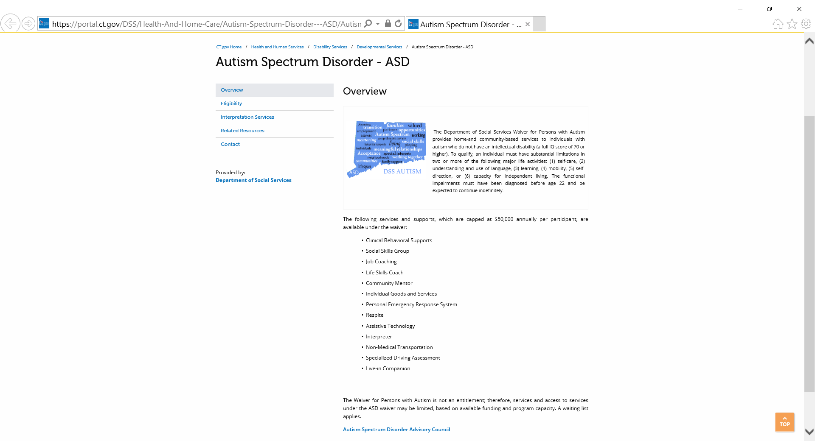

Slide 15
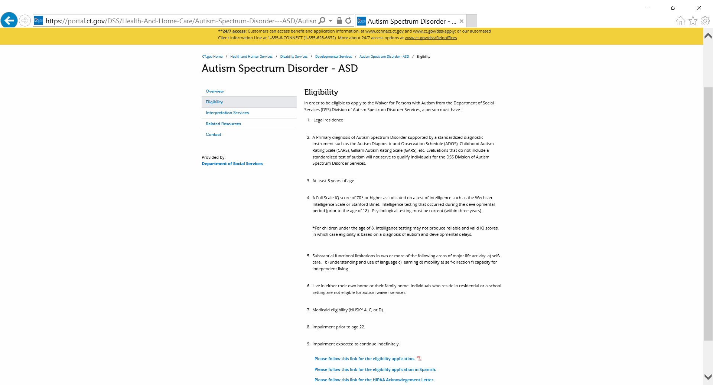

Slide 16
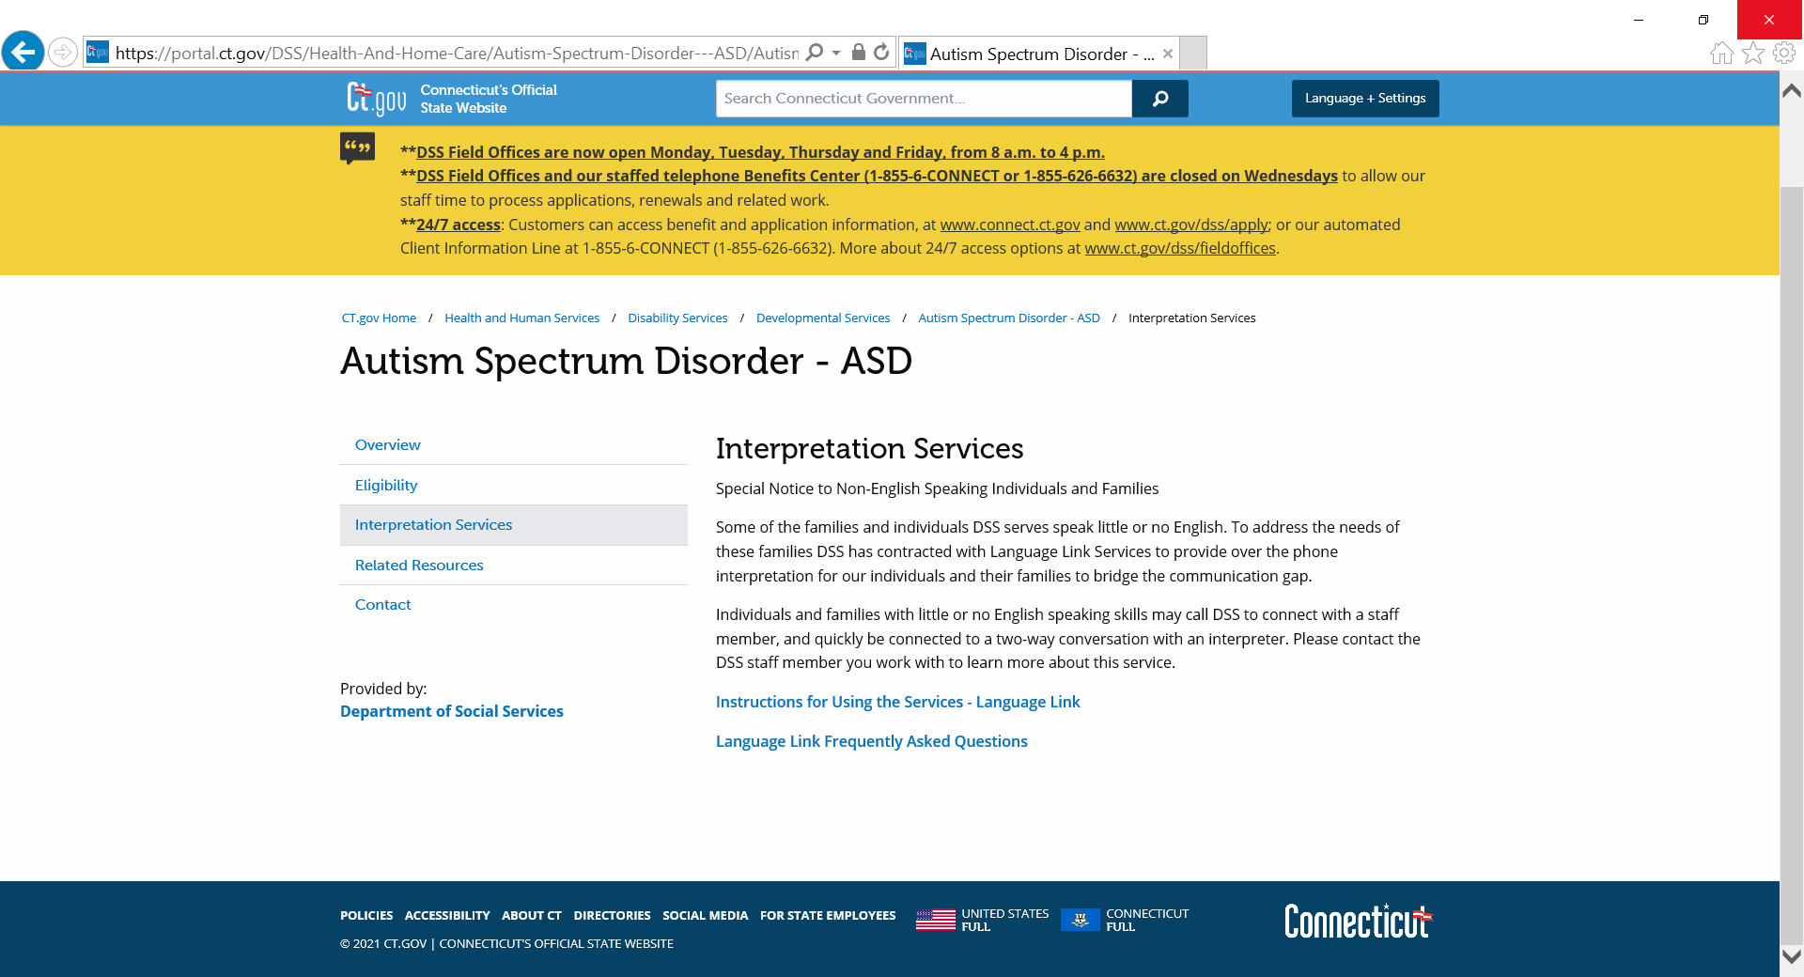

Slide 17
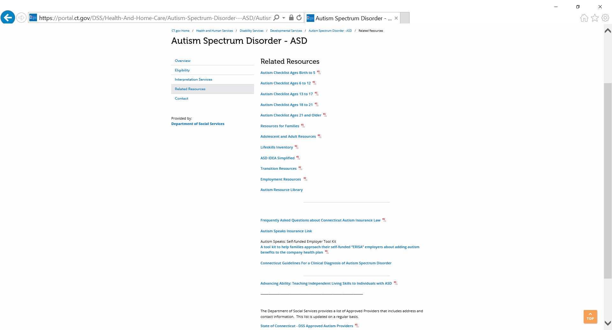

Slide 18
